Slide 1



Slide 2

3.) Curriculum
This quality is concerned with the coherence, logic and appropriateness of the curriculum in the context of the school

Slide 3
3.1 How broad, balanced and engaging is the history curriculum?
.
As a staff we designed a coherent and progressive curriculum that considers knowledge, understanding and processes/methods in a coherent way that is appreciated and enjoyed by different types of pupil across the whole school cohort. Explicit focus is given to the statutory requirements as well as the needs of all pupils and the heritage of the pupils within the school hence why we chose to study ancient Baghdad. The pupils requsted to research into WW1 so we have included this too. We have a strong focus on inclusivity. A good, balanced coverage of different periods and geographical scales, including local/regional, national, European and global.
Our 2 year cycle can be accessed via the link below.
Evidence 1
https://www.balderstoneschool.co.uk/page/?title=History&pid=84
We strive to use all our wonderful local resources; including people, buildings and resources to bring history to life. Example- the KS1 children got to interview the head teacher that once lived at the school. They also got to hold a piece of history in their hands in the form of the old school logbooks and find out the similarities /differences of school life today.

Slide 4
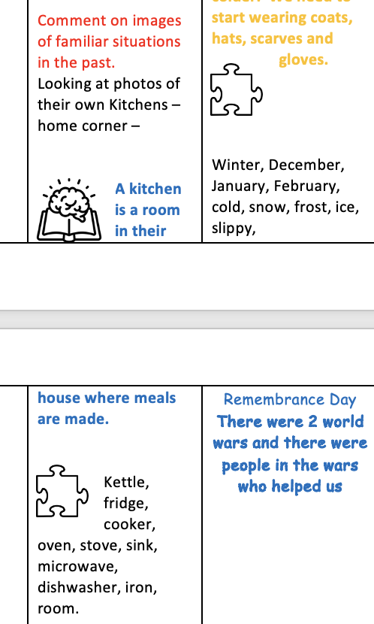
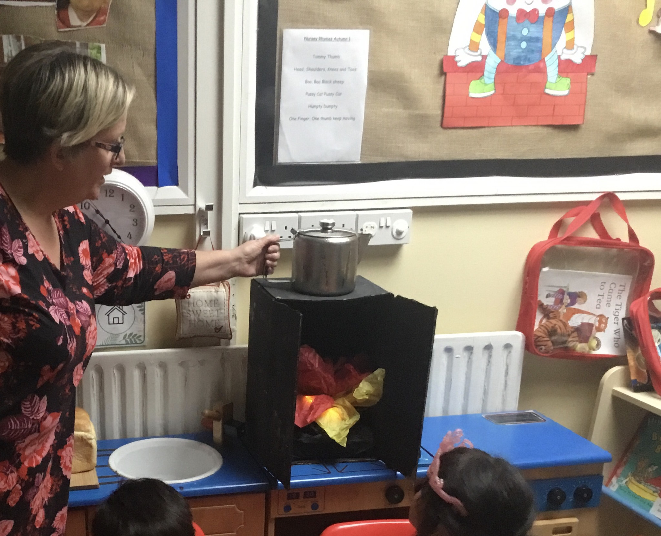
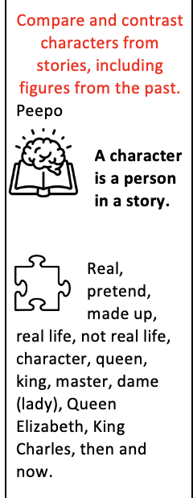
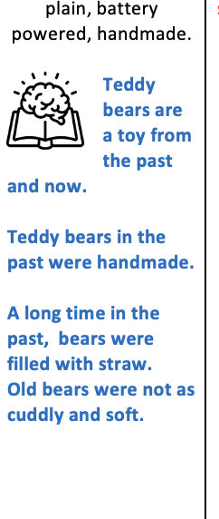
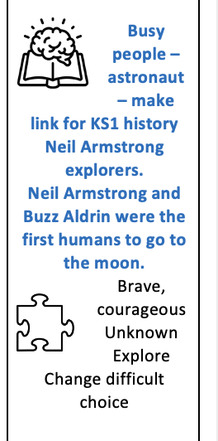

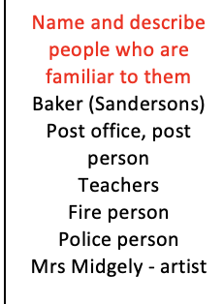
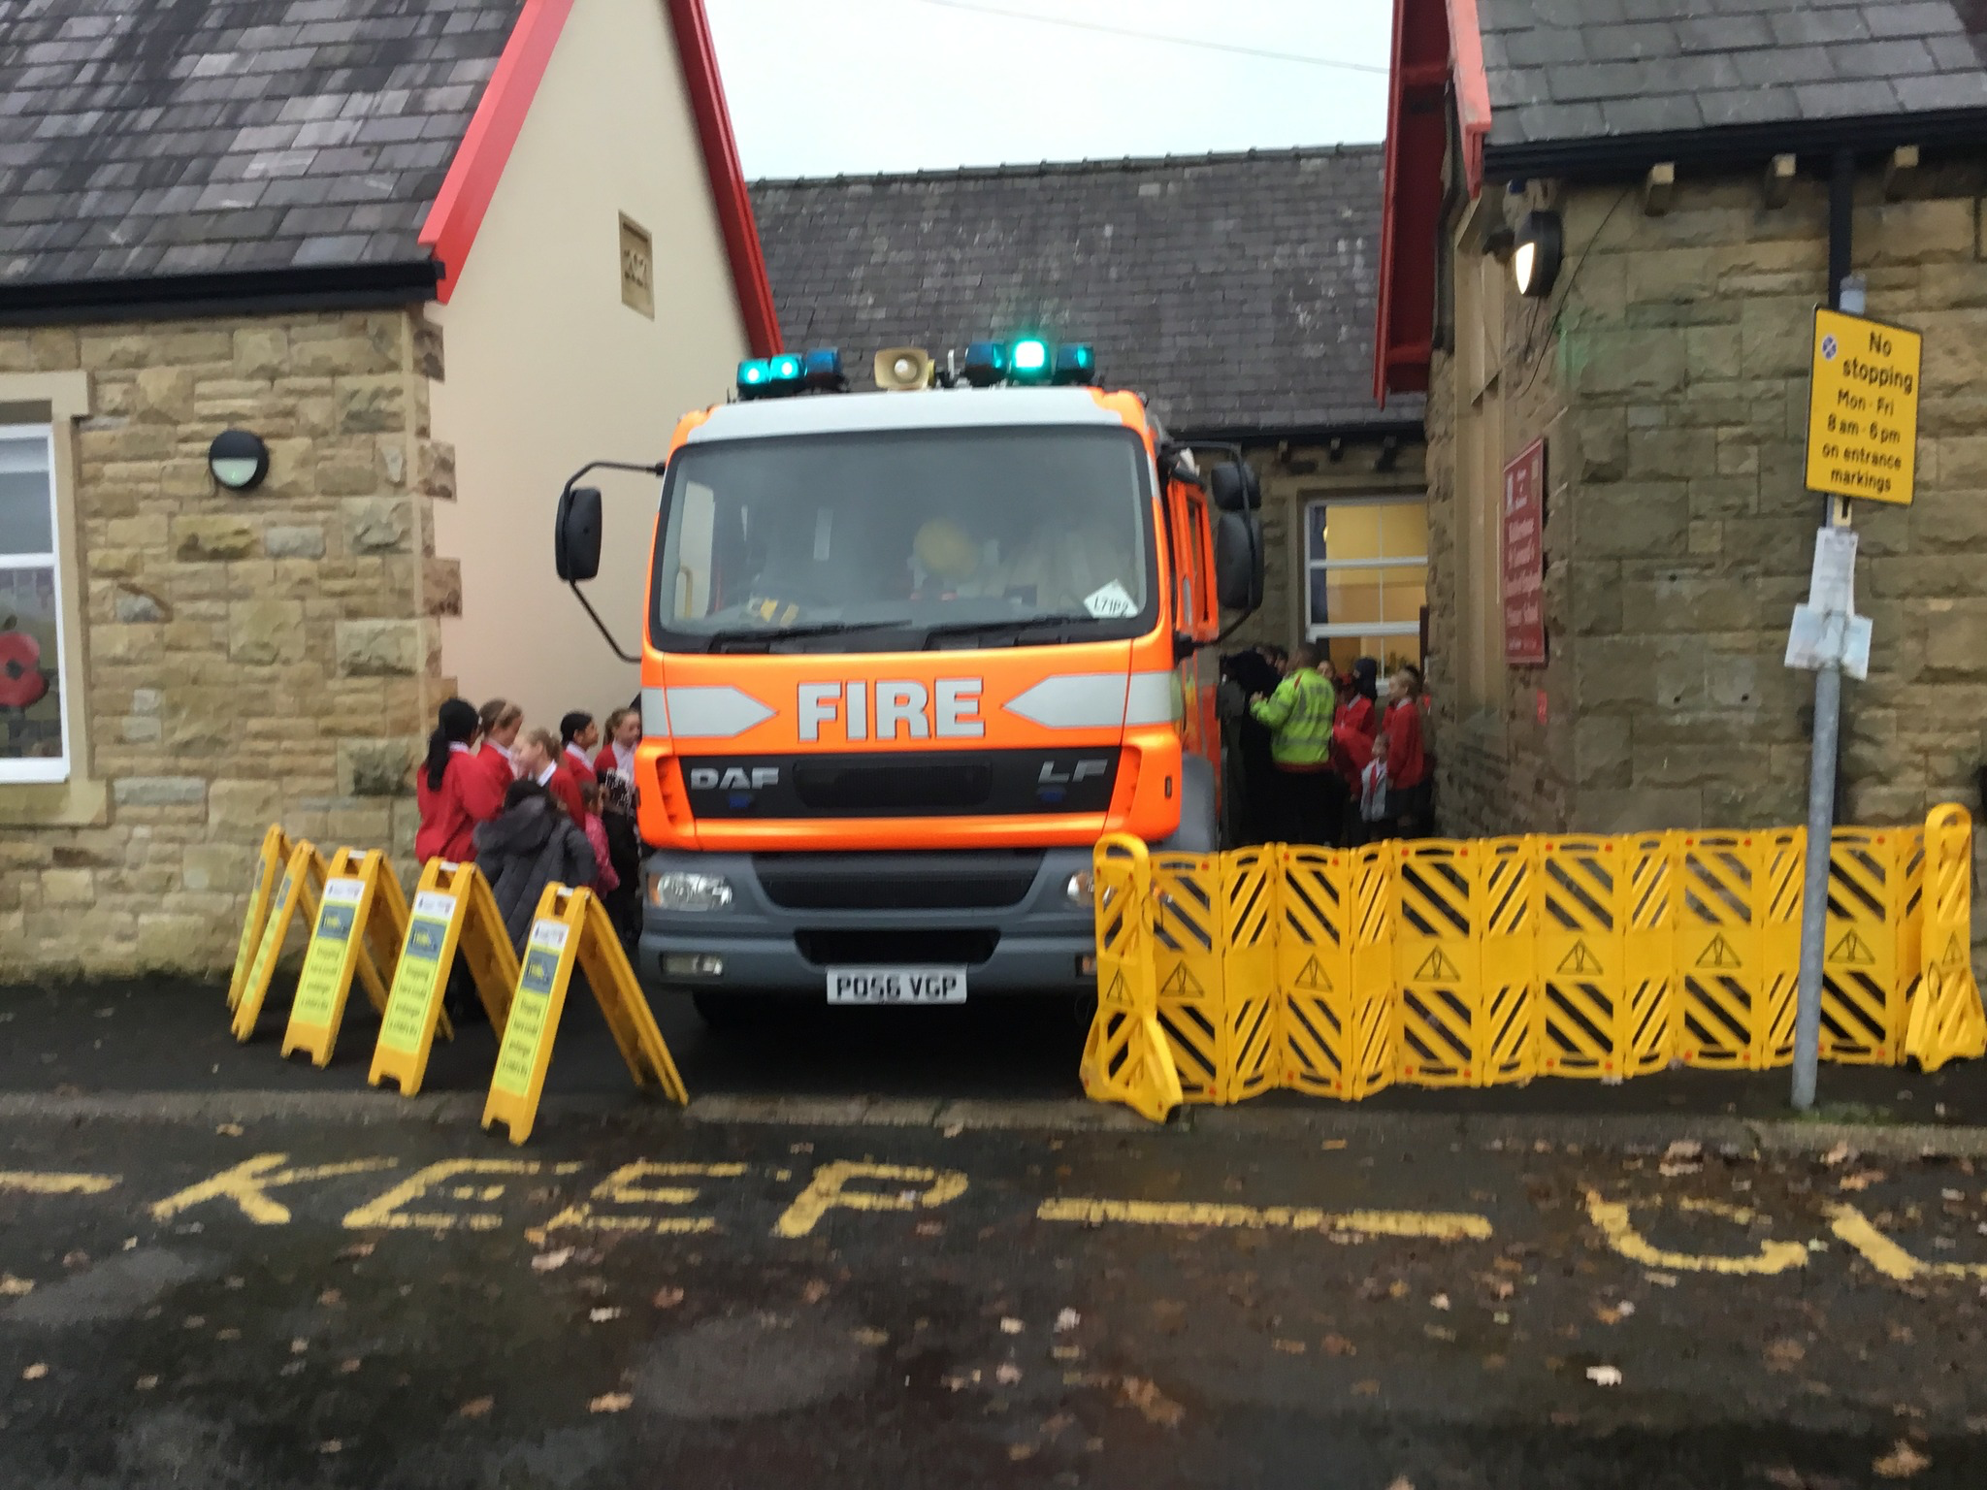
History focus - plating the history seeds – EYFS

Slide 5

3.2 How aware are pupils of links and connections between the history covered?
This is an audio recording of the children discussing connections they have made in History – click on sound button to hear.

Slide 6
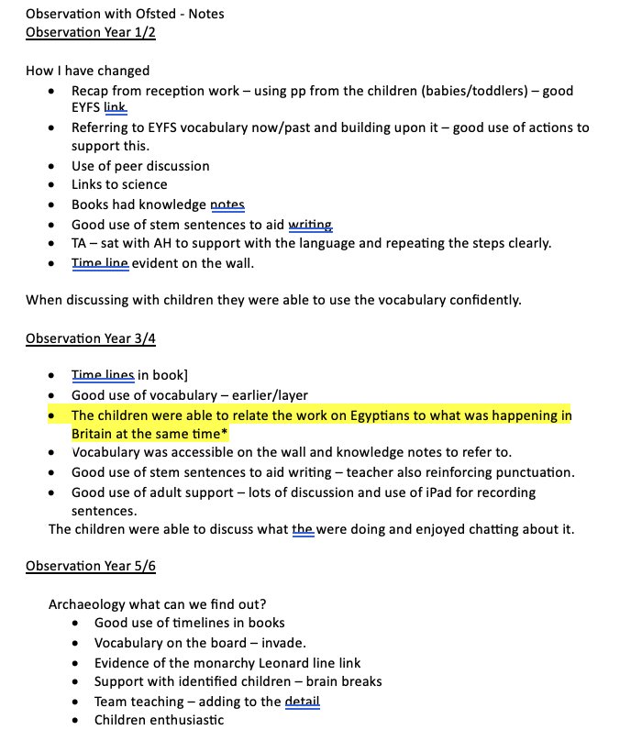
The Ofsted inspector (inspected 2nd week September 2023) noted about the links the children were making between the Ancient Egyptians and what was happening in Britain.

